Slide 1


ElasticJenkins plugin
Jenkins nearly High Available
07th October 2018
Presented by: Mathieu Coavoux
Version: 0.1

Slide 2
Agenda
Project context
Plugin architecture
Example of implementation
Demo

Slide 3
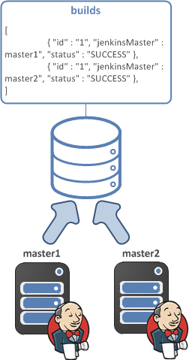
Jenkins and Elasticsearch

Slide 4
Why data persistence in Elasticsearch
View builds result of others Jenkins Masters
Keep a long history of your builds without impacting the performance
Search your old builds
Save queued items in the persistence store to prevent lost
Recover queued items automatically when a master is not available

Slide 5
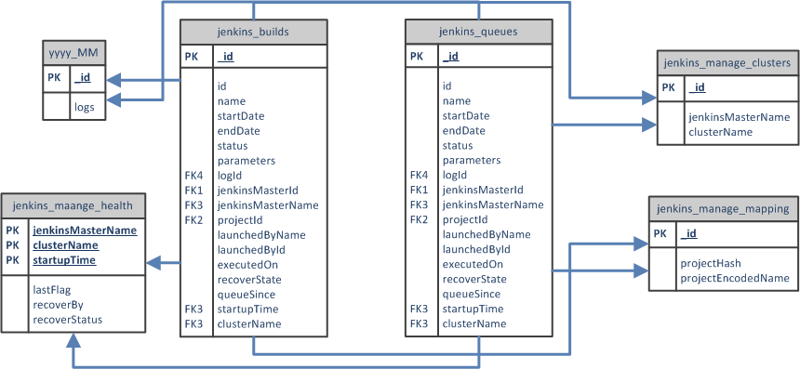
Data model
All items in queue are store in the jenkins_queues index, when they start to be built they are stored in jenkins_builds index.

Slide 6
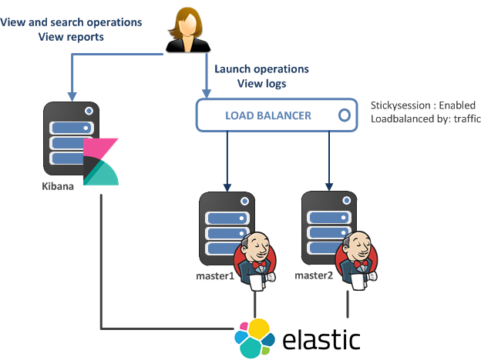
Two active masters architecture

Slide 7
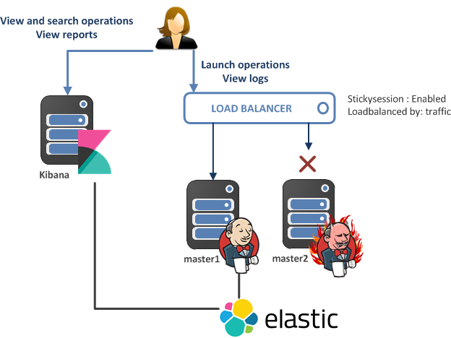
Two active masters architecture

Slide 8
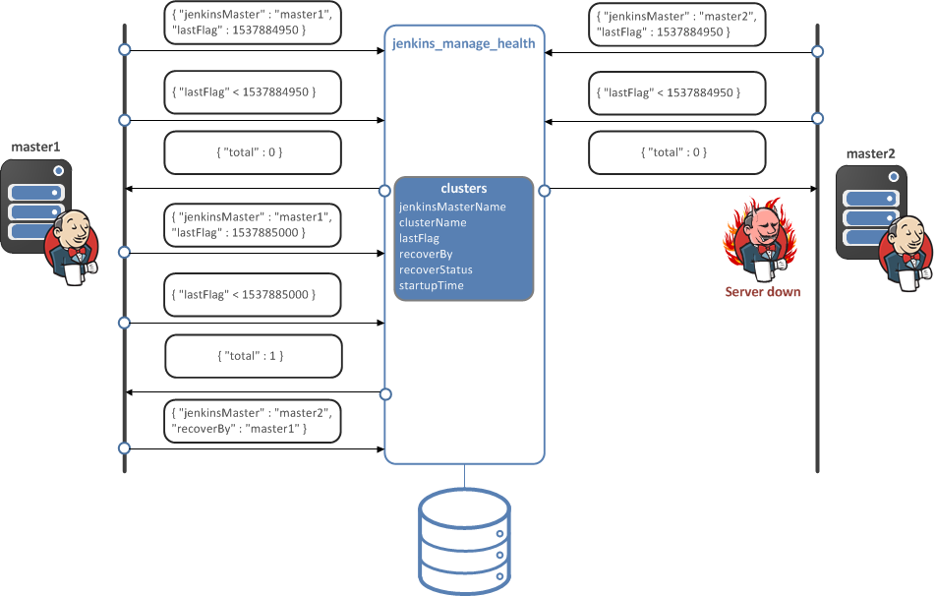
Healthcheck

Slide 9
Demo

Slide 10
Thank you

